Slide 1
Rebuild the Utopia University Library (UUL)
Group Four
The 16th Annual Library Leadership Institute
2018

Slide 2
Prepared by
Ho Yuen Sze, Anna
Lo Ricky
Pun Priscilla Nga Ian
Tengku Mohd Suhaimi Raja Abdullah
Tu Yi Chien
Yee Wai Man Jenny
Zhang Qiu

Slide 3
Group 4

Slide 4
Proposal
Rebuild the library without books and meet the teaching and learning, research and knowledge exchange needs of the University.

Slide 5
To Achieve
Collaborative with one of the following partner on campus to support teaching and learning, research and knowledge exchange.
Student Support Services
Information Technology Services
Museum or the University Publisher

Slide 6
Overview
Contents
To rebuild the collection by developing the electronic resources, open access resources & digital collection
Tools
Advanced infrastructure, equipment, and software, etc.
Spaces
Transform the library (exhibition area / multi-functional area)
1.Local and Global Libraries, 2. Publisher and content provider; 3. Open Access Sources (society and government)

Slide 7
Student Support Services
Student Support Services
Information Technology Services
Museum or the University Publisher

Slide 8
Rationale for Making the Suggestions
Teaching and learning are now student-focused
Students are the largest part of stakeholders in the community
Basic technical support is already available within the campus, no need to duplicate resources
Publishers support is not a priority in need at the initial stage

Slide 9
Directions: Transformation
From Traditional to New
Actively engage students in library planning, and decision-making;
Create all-rounded student support services in collaboration with other parties concerned.

Slide 10
How to do it?
Survey for students, faculty members and other involved parties
Participation and leadership in student-focused activities
Form a working group with the research and student parties to identify the needs of the stakeholders
Provide support for digital thinking and digital scholarship in library spaces (workshops, digital literacy)
Use online platforms to connect, respond and interact with stakeholders such as instant messaging and virtual reference services

Slide 11
Aims of the Survey
Collect ideas from how to re-build the library;
Understand and analyze usage patterns;
Fill the gaps between the library and library users.

Slide 12
Aims of participating students activities & working groups
Let users involve in re-building the library;
Promote initiatives to increase library visibility;
Keep track on the trend of learning and research activities;
Change the mindset of library staff, reach out faculty staff & students.

Slide 13
Resource Implications - Manpower
To prepare and conduct survey
To form a working group
Interlibrary loans and Document Delivery Services
To strengthen the information literacy and digital literacy for user
To develop the e-resources, open access collection
Exhibition /Workshop/Forum /Sharing/Seminar (formal and informal)
Leadership training program (Staff and Students)
Enhance the virtual services

Slide 14
Resource Implications - Budget Concerns
Provide tokens for conducting the survey / interview to attract the active engagement of stakeholders
Fees for materials delivery (ILL, DDS)
Pay per view from content providers
EBooks with unlimited users
Demand Driven Acquisition (DDA)
Speaker remuneration

Slide 15
Indicators to Measure the Success
Quantitative
Statistics (usage of ILL / DDS, electronic resources, virtual services)
Turnaway statistics
Attendance of library events (workshops…)

Slide 16
Indicators to Measure the Success
Qualitative
Rating for satisfaction (stakeholders)
Literacy evaluation for improvement analysis
The gap between importance vs performance

Slide 17
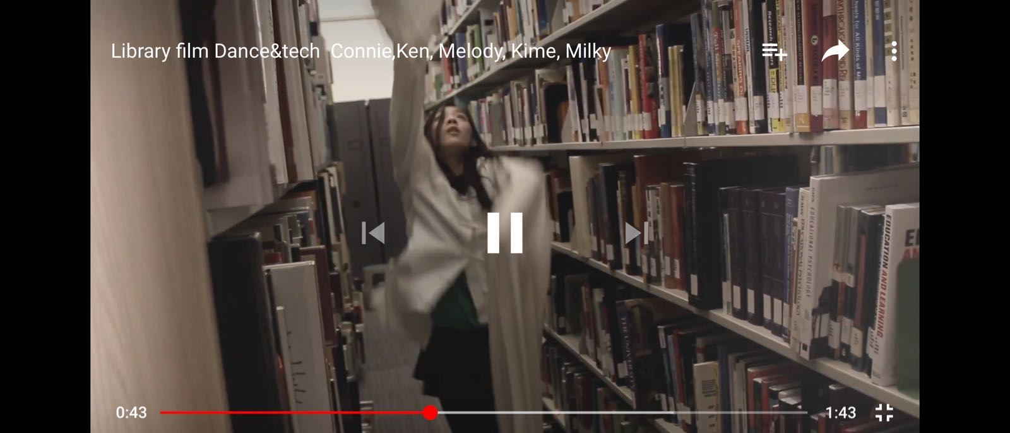
Engage Students in Library Event
https://youtu.be/2htD8XGvUoU

Slide 18
Thank You!

